Slide 1
Lyrics Generator with NLP models
CS662/Info662 Final Project
Dawson Sargent, Chenghui Song, Kelvin Yi

Slide 2
Steps:
(i) process the text into vectors and
(ii) train a neural network with these vectors.

Slide 3
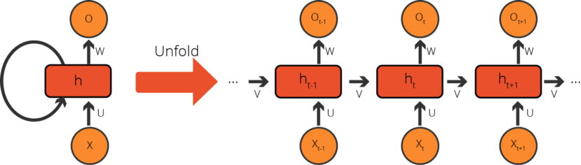
About Recurrent Neural Networks (RNN)
Derived from Feedforward Neural Networks, but they offer much more
Take the order into account by using previous information kept memory
Sequential input
Output predictions in different lengths
Types of RNN
Vanilla RNN, GRU, and LSTM.
A Cell-Based Recurrent Neural Network Activity

Slide 4
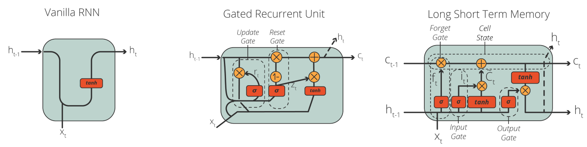
Types of RNN
Simple RNN
Long Short-term Memory (LSTM) Networks
Gated Recurrent Unit (GRU) Networks

Slide 5
The current models
Generate meaningful text from
Characters
The model learns the styles of the input text and generates similar text
Words with Markov Chains
The model learns the styles including the sequence words and rhythms of the sentences
Lyric corpus from Bee Gees songs has 116k words (440k characters)
Lil Wayne’s lyric corpus has 390k words (2m charcters)

Slide 6
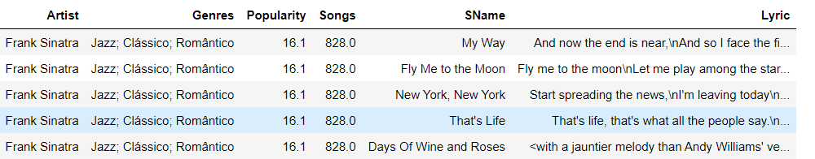

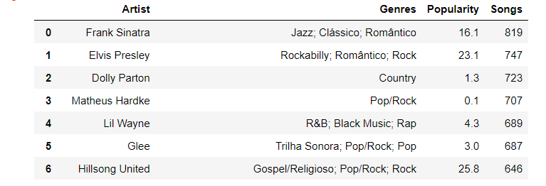
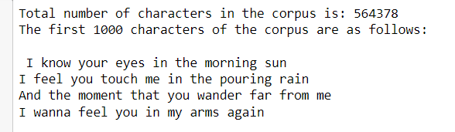
Data Preprocessing
Data source: https://www.kaggle.com/datasets/neisse/scrapped-lyrics-from-6-genres?select=lyrics-data.csv
lyrics-data.csv and artists-data.csv
1. Create dataframe of artists and their songs
2. Create list most popular artists and # of songs in this dataset
3. Select an artist to generate the lyric corpus

Slide 7
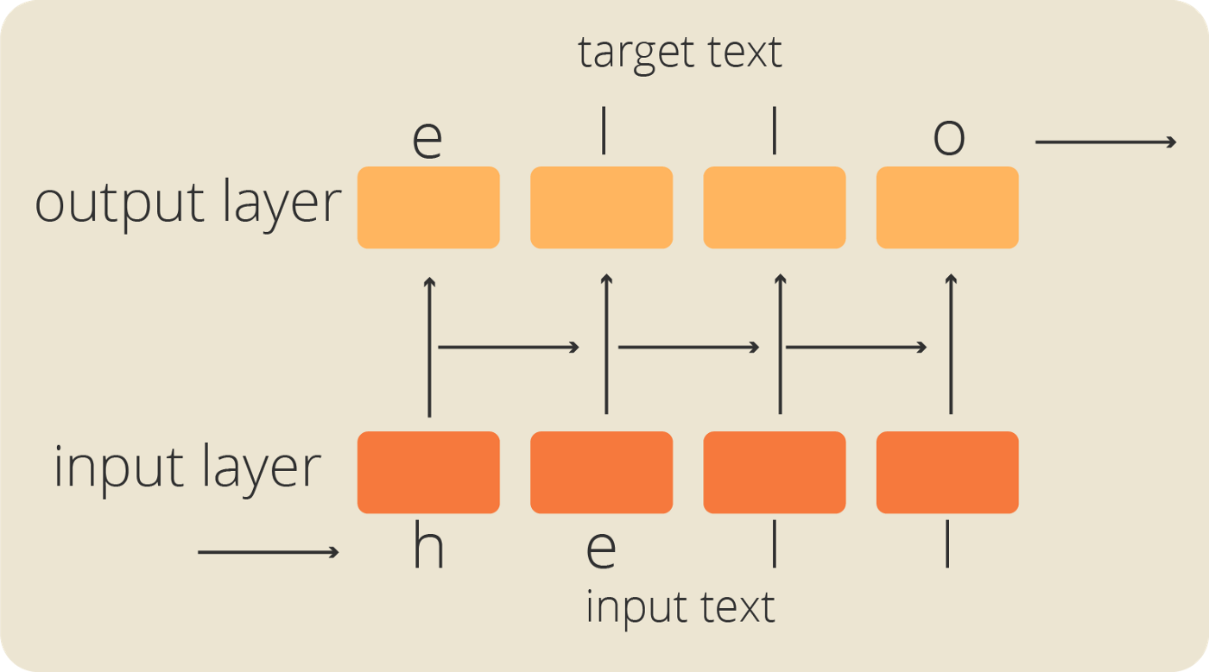
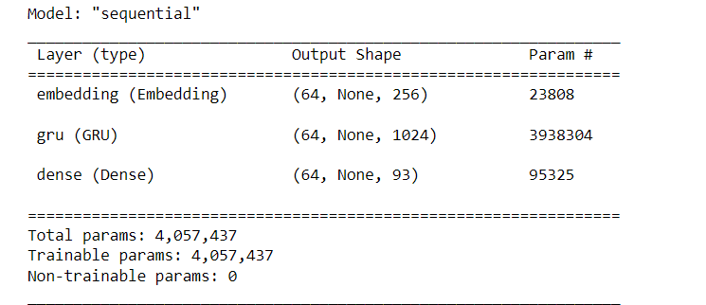
Model 1: use characters as input sequences
Vectorizing the Text
Find all unique characters from the corpus
Assign a number to each character
Example of input-output layers of the model
Char-to-index
Index-to-char
Vectorize the whole corpus
de-vectorize (Decoding)
TensorFlow Dataset object
Batches (max 100 chars per seq)

Slide 8
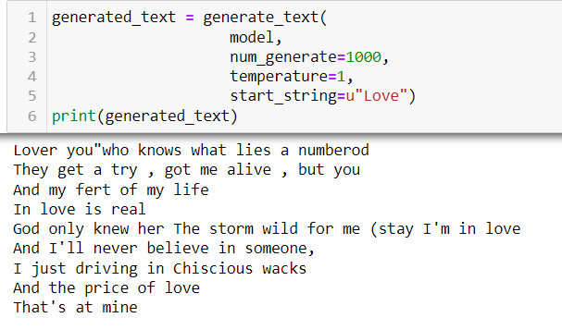
More about the model:
Adam as optimizer
sparse categorical crossentropy function as loss function
Generate New Text
Train the model and save the weights
Build a new model with epoch = 1 and saved weights

Slide 9
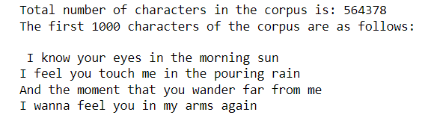
Model 2: use words as input sequences
Important parameters
maxsyllables: max # of syllables per line;
max_overlap_ratio: how different the output should be from the original input;
tries: how many times to try to build a line that satisifies some parameter;
epochs: how many times for the NN to pass over the data.
To reduce computational complexity, maximize (1) and (2) and minimize (3) and (4). Computational time will increase dramatically when (1) is less than 8 and when (2) is less than 0.5
Plot most commonly used words
Create the RNN layers and Markov Chain
Determine the rhyme scheme
Determine number of syllables in line
Make index of words that rhyme with your word
Make index of rhymes that you use
Separate each line of the input txt
Generate lyrics and build dataset
Compose verse

Slide 10
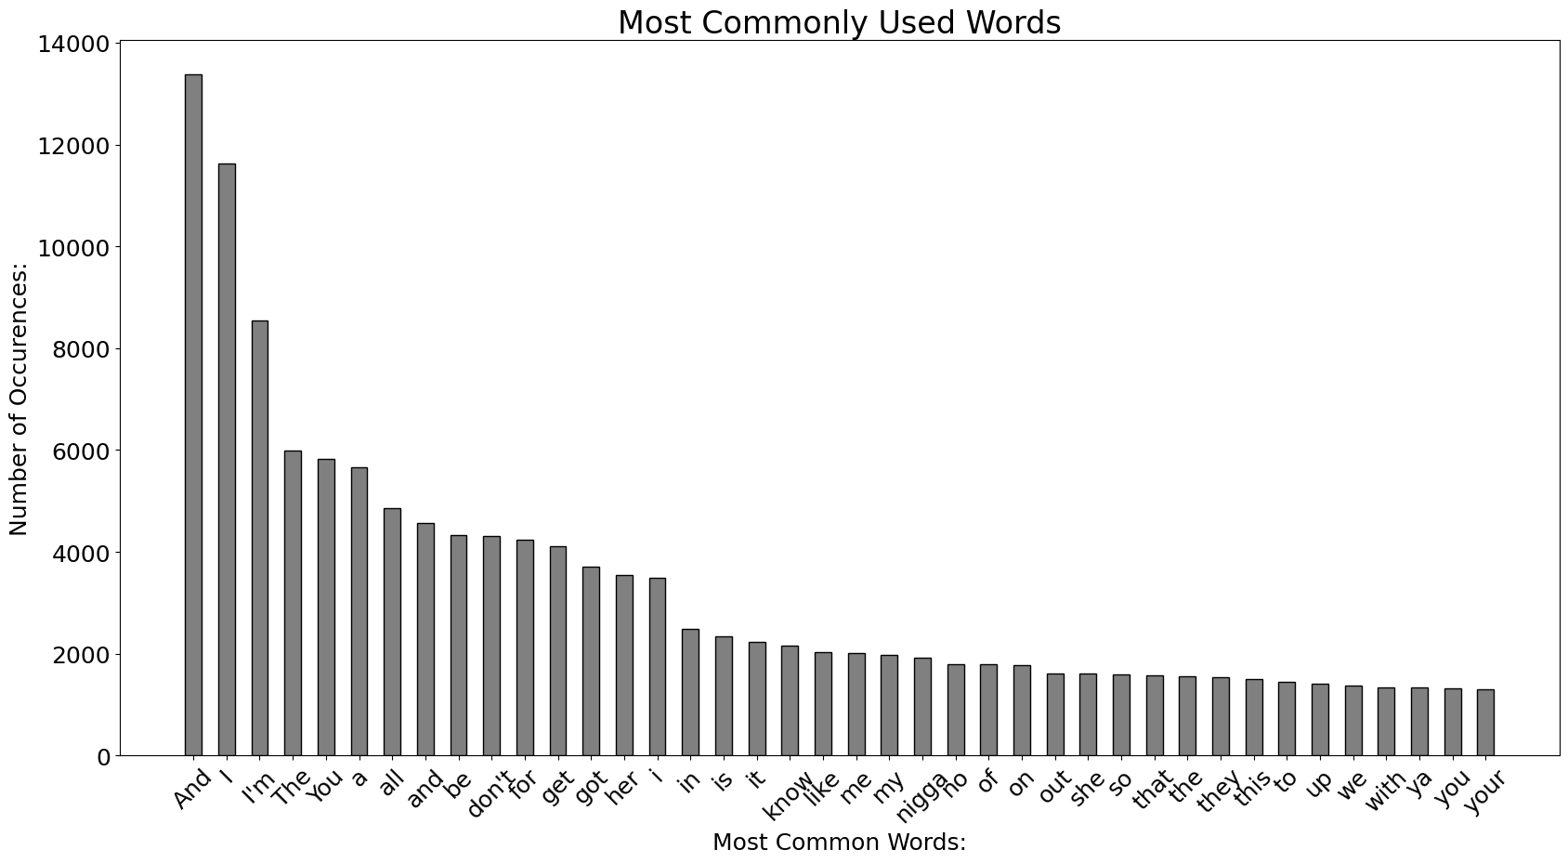
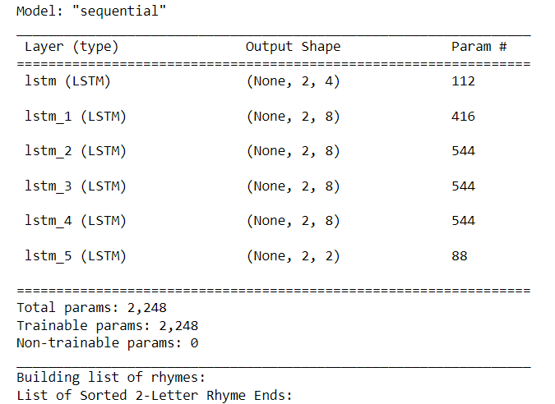
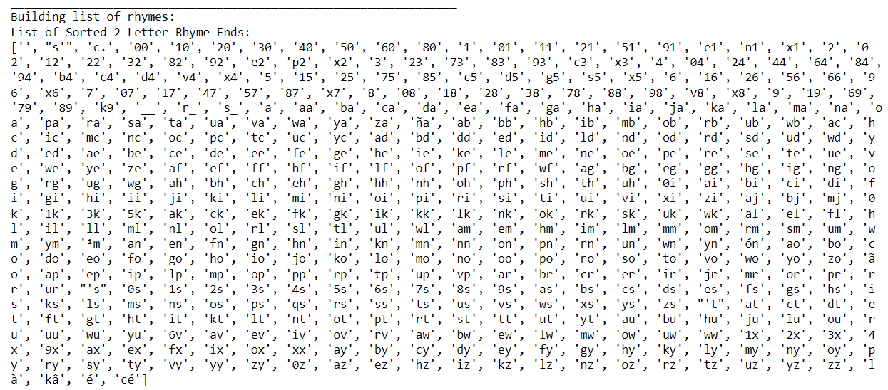

Slide 11
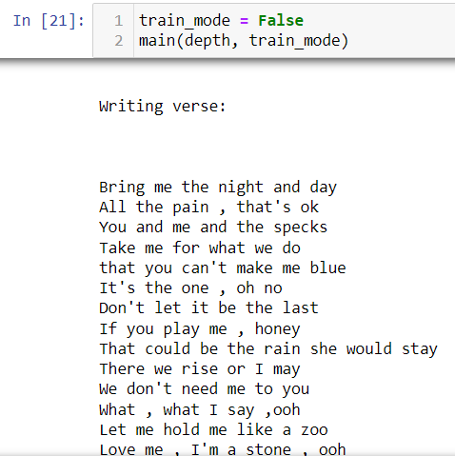
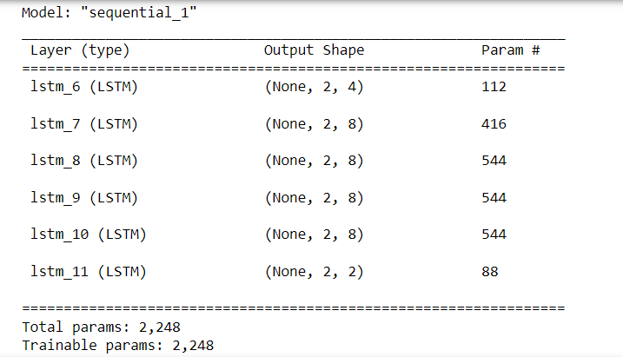
Generate New Text

Slide 12
main
Text_model
model
Create_network
depth
Train_mode
Split_lyrics_file
Text_file
(Lyrics_file)
Save weights
train
bars
x_data
build_dataset
y_data
rhymeindex
markov
Compose_rap
Non_Train_mode
vectors
rhyme_list
generate_lyrics
Text_model
Vectors_into_song
rap_file
rap
Build_dataset
rhyme
rhyme_list
dataset
line_list
line
lines
syllables
Text generate

Slide 13
Function Structure
Text_model
main
Train_mode
model
Create_network
depth
Split_lyrics_file
bars
Text_file
(Lyrics_file)
Save weights
train
x_data
build_dataset
y_data
rhymeindex
markov
Compose_rap
vectors
rhyme_list
Text_model
Load from memory
generate_lyrics
Vectors_into_song
Non_Train_mode
bars
rap_file
rap
Build_dataset
rhyme
rhyme_list
dataset
line_list
line
lines
syllables
Text generate

